Slide 1


ELLIS GUILFORD SCHOOL
Parent Information Evening

Slide 2





ELLIS GUILFORD SCHOOL
Miss Johnson
Principal
Mr Farnie
Vice Principal
Mrs Hudson
Vice Principal
Mr Neville
Year 9 SLT Link
Mr Snow
Head of Year 9

Slide 3
EGScellence
Our mission:
To ensure that the children attending our school receive the very best deal when it comes to their education.
Notes:
A deep rooted belief that we want this school to be the very best it can be. Our children deserve to go to a school that they are proud of and that gives them the very best education. To do that, I need your help. We are a partnership and it simply will not work if we don’t work together.

Slide 4

A Culture OF EGScellence
The way we do things here, in every interaction, every day.
Notes:
Three values – voted for by our children. We have the highest expectations of our children – this is our culture of EGScellence.

Slide 5


Pledges in Practice
We want to celebrate our school values being brought to life beyond the classroom! You are encouraged to reflect on how you have demonstrated ambition, integrity or respect. Whether at school, at home or in our community.
Share your Pledges in Practice with us via email, or our MS Form!
https://www.ellisguilfordschool.org.uk/parents/pledges-in-practice

Slide 6

A Culture OF EGScellence
The way we do things here, in every interaction, every day.
What are EGSpectations?
This is how we do things here.
We make our boundaries and expectations clear, so that school feels fair and safe, allowing positive relationships to thrive.
Our routines are called EGSpectations. EGSpectations are the clear routines that we have for all stakeholders of our school.
Our EGSpectations define our attitudes, behaviours and expected achievements across our school community.
Each EGSpectation embodies our school values, culminating in a high-performing environment.
We share our EGSpectations clearly with all and we repeatedly model routines.

Slide 7
Overview of EGSpectations
Culture EGSpectations
Strong Start | Manners Matter | Never a Bystander
EGScellent Uniform | Every Lesson, Every Time | Perfect Punctuality
EGScellent Equipment | Assembly | Line-Up
Strong Finish | Calm Corridors | Family Lunch
TRACK
Classroom EGSpectations
First Five | Learning Objective Annotations | Solo and Silent
Choral Response | TRACK | Final Five
Everybody Writes | Say It Again, Better | I Say, You Say
I Say, You Spell | Turn and Talk | Check for Understanding (MWBs, Cold Call, No Opt Out)
EGSpectations for EGScellence
Ellis Guilford School: Where EGScellence thrives, and the EGSceptional shine

Slide 8
How You Can Support Our EGSpectations
Check uniform and equipment daily – Help your child feel prepared and confident.
Encourage positive routines – Good sleep, punctuality, and calm mornings make a big difference.
Celebrate effort and kindness – Praise behaviours that reflect EGSpectations.
Stay in touch – Let us know if your child needs support with any aspect of school life.
EGSpectations for EGScellence
Ellis Guilford School: Where EGScellence thrives, and the EGSceptional shine

Slide 9

EGScellent Uniform
Reminders:
  Blazers must worn around the school
  No hoodies
  Black polishable shoes
  Grey Skirts/shorts – knee length or just above the knee
  Jumper – Optional – must only be worn with a blazer

Slide 10

EGScellent Equipment
Bring a school bag 🎒
Make sure it’s big enough to carry everything you need, including your knowledge organiser.
Keep your knowledge organiser safe 📚
It should be stored in a plastic wallet to protect it.
Have your pencil case ready ✏️
Your pencil case should include:
  Black pens 🖊️ for note-taking
  Blue pens 🖊️ for independent work
  Green pens 🖊️ for feedback
  Pencil ✏️ for drawing
  Eraser 🧽 for corrections
  Ruler 📏 for neat lines

Slide 11
📊 Assessments
Your child will be regularly assessed in all subject areas – this is to monitor their progress and provide additional intervention if needed.
The children will track their progress after each assessment.
The children will have Common Trust Assessments (previously known as PPEs):
  Year 7 -10: Summer Term 2026
  Year 11: January 2026*
Notes:
Teachers will be in touch with you if there are any concerns. You can also email in to school to

Slide 12
🧠 Year 8/9 Homework
The children will be set homework on a weekly basis.
For the first half-term (up until October), it will be Sparx Maths and Sparx Reader only.
After October half-term, all subjects will introduce knowledge quizzes.
Homework will be set from Monday 8th September for Maths & English.
Homework completion is SO important in helping your child improve and retain knowledge.

Slide 13
Ellis Electives
Will begin shortly into the Autumn term.
After school sessions from 3.10pm-4.10pm.
Children are encouraged to attend.
The library is open every day after school until 4.10pm.

Slide 14




Recognising EGScellence
Daily Recognition:
Guilford Gold every day
EGScellence Cards and Stamps
EGScellence Stamps in Planner
EGScellence Award (1 per lesson)
Weekly Recognition:
Year Group Assembly Rewards
Party with the Principal (every Friday)
EGScellence EGStravaganza (at the end of every half term)
Once per academic year:
Ambition, Integrity and Respect Awards
EGScellence Awards

Slide 15

MOBILE PHONES
We are a mobile phone free school
Mobile phones are not to be seen, heard or used at any time.
Phones will be confiscated is seen, heard or used
Children will receive a 30-minute reflection
Children may bring a mobile phone to school for the journey to and from school, but it must be switched off and out of sight at all times.
Refusal to hand over a mobile phone in a confiscation will result in a serious sanction including being unable to have a phone on the school site

Slide 16
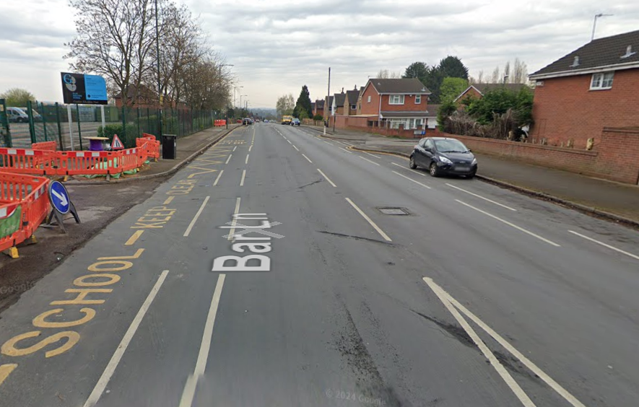
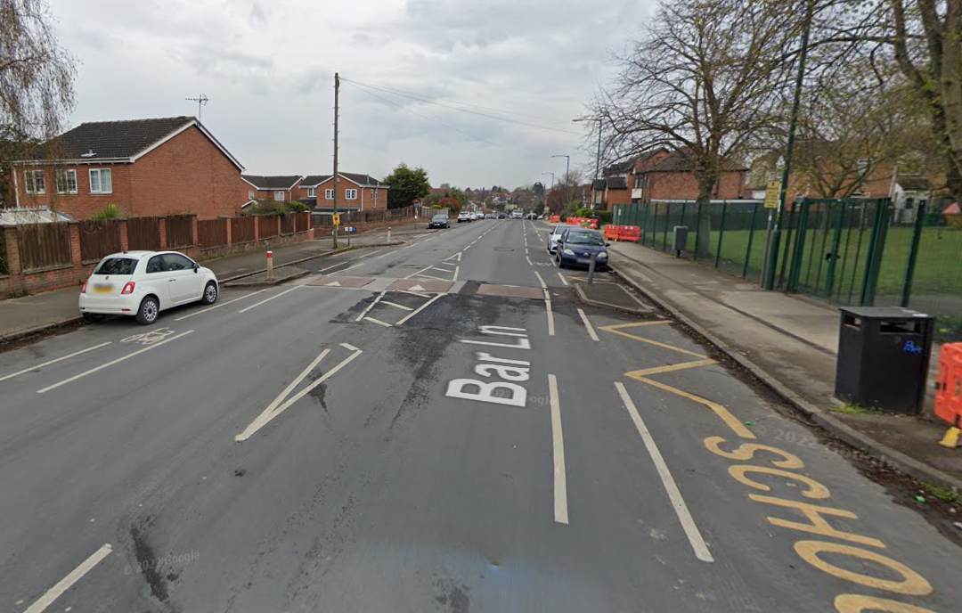
ROAD SAFETY

Slide 17



Slide 18
Attendance
Children at EGS who have more than 95% attendance achieve better than other children nationally!
EGSpectations for EGScellence
Ellis Guilford School: Where EGScellence thrives, and the EGSceptional shine

Slide 19
Attendance
Give your child the best chance of success and insist they attend school every day!
EGSpectations for EGScellence
Ellis Guilford School: Where EGScellence thrives, and the EGSceptional shine

Slide 20





The EGS House System
2025-2026
Bocelli | Chawla | Copeland | Elion | Turing
Ms Evans | Mr Beg | Miss Dorrian | Miss Anthoney | Mrs Linton
Notes:
Team building – children and staff (Respect)
Enjoy your school experience (fun!)
Motivate you to succeed (Ambition)
Develop leadership skills
Healthy competition!

Slide 21
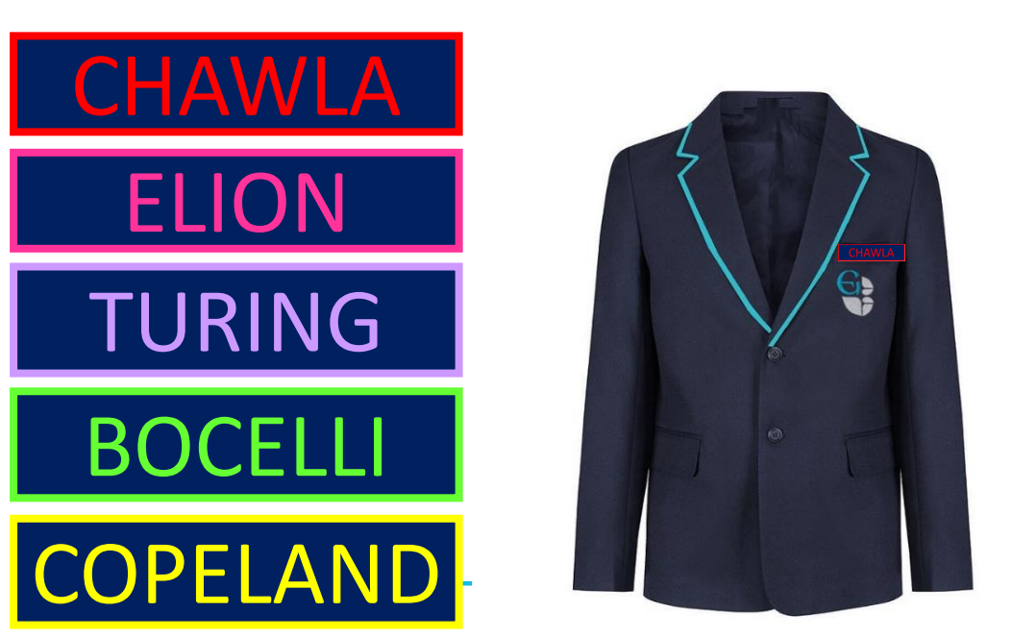


Slide 22

A Culture OF EGScellence
The way we do things here, in every interaction, every day.
Communication
We want your child to be successful. They belong to our school and we care about them.
Please work with us to support them to be their most successful self.
Arbor App
Emails
In-App messages
Facebook
Ellis Echo – weekly

Slide 23

A Culture OF EGScellence
The way we do things here, in every interaction, every day.
Ellis Guilford School Community Hub
New for 2025-2026
Safe, warm space for our community to gather
SEND support group every fortnight – dates have been announced via email
Drop-in Coffee Morning every Friday from 9.00am
Macmillan Coffee Morning – 26th September from 9am-12pm
Pre-loved uniform shop

Slide 24
ELLIS GUILFORD SCHOOL
Parent Information Evening

